Slide 1
Business and Industrial Economics
A.Y. 2023/2024
Prof. Mattia Pedota
Firm Growth: Diversification and Vertical Integration

Slide 2
Note
Short-run | Long-run
1 fiscal year | More than 1 fiscal year
“Tactic” | “Strategy”
Changes in production levels
Optimization and variation of the production mix
Make-or-buy choices for contingent reasons (e.g. demand peak)
Organizational structure
Adopted technology
Plants size and new machinery
New products or processes
Entry to / exit from the industry
Diversification
Delocalization of some activities
max (Revenue - Avoidable Cost)
Fixed Costs are not considered
Expected present value of revenue and cost flows
Focus of this lecture and the following

Slide 3
Firm boundaries
Horizontal boundaries of the firm
Quantity of products
Lateral boundaries of the firm
Variety of products
Vertical boundaries of the firm
Number of integrated steps along the supply chain
International boundaries of the firm
Geographical span of firm activities

Slide 4
Firm boundaries
3. Vertical
3.1 Backward
3.2 Forward
1. Horizontal 2. Lateral
2.1 Related diversif.
2.2 Unrelated diversif.
3. International
3.1
Mozzarella
factory
4
Importing tomato sauce
2.2
Department store
2.1
Burger restaurant
Pizza restaurant
1
Pizza restaurant
4
Pizza restaurant in NYC
3.2
Home delivery

Slide 5
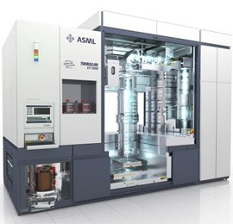
Horizontal boundaries
Economies of Scale
Horizontal expansion
Cost
y

Slide 6
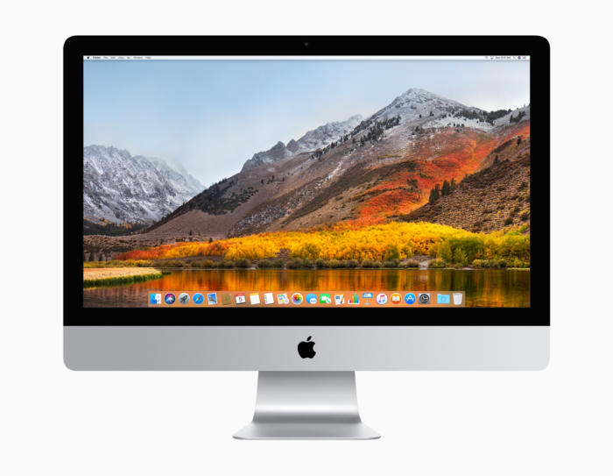

Lateral boundaries
Economies of Scope
Related diversification
Cost
N_{y}

Slide 7


Lateral boundaries: Conglomerates involved in unrelated diversification
Tata Group
Information Technology
Energy
Pharmaceuticals
Italian handcrafted furniture
Automobiles (Tata, Jaguar and Land Rover)
Hyundai Group
Steel production
Elevators
Ocean shipping
Automobiles

Slide 8
Diversification
Why do firms diversify?
Benefits | Costs
Economies of scope (spreading the firm’s resources, capabilities and managerial talent over many uses)
Ex-ante costs (implicit and explicit costs incurred to acquire a company or to set-up an entrepreneurial venture)
Other synergies (Addition of value to extant businesses, transfer of skills and knowledge, cross-business collaboration)
Ex-post costs (coordination costs, reduction in incentives, slower information flows )

Slide 9
Diversification
How do firms finance it?
Internal capital market
vs.
External capital market (debt and equity markets)

Slide 10
Diversification
The choice to diversify ultimately depends on a cost and benefit analysis: are synergies and economies of scope sufficiently high to overcome financial, entry and coordination costs?
Three conditions should be satisfied:
Attractiveness test: the target industry should be structurally attractive
Cost of entry test: the cost of entry should not exceed (expected) future profits stemming from the target industry
Better-off test: strong synergies should be present between the two businesses (2+2→6)

Slide 11
Diversification
However, the cost-benefit analysis is often biased, and diversification happens much more often than it should
Why?

Slide 12
Diversification
Managers can significantly benefit from diversification:
Social prominence, public prestige and political power (building an empire)
Limit managerial risk: diversifying limits managers’ risk of achieving a poor profitability overall
Corporate Governance issues

Slide 13
Diversification
What mitigates corporate governance issues?
Monitoring (e.g. board of directors)
Incentives to managers (e.g. profit-based compensation)
Capital market discipline (e.g. takeovers risk)
Labor market discipline (e.g. managers reputation)

Slide 14
Diversification
1) Board of directors (BoD)
Monitor the management to ensure that actions are taken to increase shareholder value
However, high-level managers may exert considerable control over the selection of new directors
Important to have external / independent members of BoD

Slide 15
Diversification
2) Incentives to managers
During 1980s’ & 1990’s: increase in leveraged buyouts (LBO), whereby cash flows of firms were used to undertake unprofitable acquisitions instead of paying dividends
Need to realign managerial incentives
One popular way to partially realign managerial incentives is to link their compensation to the value of shares of the company they direct (e.g. through employee stock options)

Slide 16
Diversification
3) Capital market discipline
If bad managers are running a company
Management tends to overpay for diversifying acquisitions
The stock market ends up internalizing this information, expecting managers to overpay for additional acquisitions in the future
The firm’s shares’ market price falls immediately
→ The opportunity arises for another entity (raider) to try a hostile takeover and appoint its own managers, with the potential to increase profitability thanks to a better management
→ Capital market discipline deters inappropriate management

Slide 17
Diversification
4) Labor market discipline
Managers’ reputation circulates in the labor market
Potential employers know whether managers pursue personal goals or organizational ones

Slide 18
Diversification
Key takeaways
Diversification allows the business to grow and benefit from synergies
Diversification is optimal only when its benefits (i.e. economies of scope and other synergies) outweigh its costs (both ex-ante and ex-post)
Empirical studies show that the performance of diversified firms is, on average, lower than the one of more focused firms: this is probably due to the fact that diversification happens more often than it should, due to self-interested managers

Slide 19
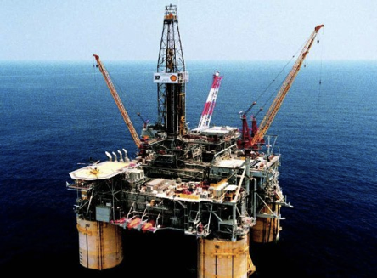
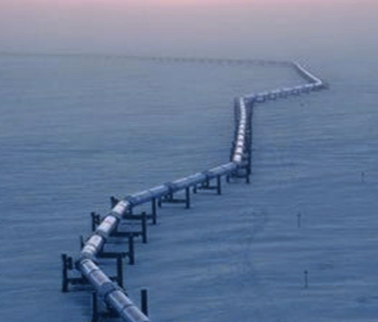


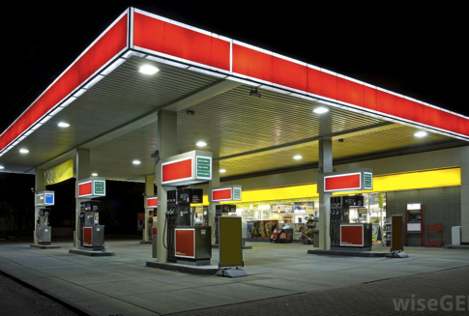
Types of vertical Integration
Supply chain
Upstream
Downstream

Slide 20
Types of vertical Integration
Non-integration example:
Firm 1 and Firm 2 are independent
Firm 1
Firm 2

Slide 21
Types of vertical Integration
Forward integration example:
Firm 1 acquires control over Firm 2’s assets
Firm 1’
20

Slide 22
Types of vertical Integration
Backward integration example:
Firm 2 acquires control over Firm 1’s assets
Firm 2’

Slide 23
The insights of property rights theory on vertical integration
Property Rights Theory (PRT):
Integration determines
Who controls resources
Who makes decisions
To whom profits are allocated
Appropriate ownership structure is conducive to efficiency
The residual right of control is the right to decide on all the situations that are not included in the contract

Slide 24
The insights of property rights theory on vertical integration
Residual rights of control over assets belong to the owner of such assets
Vertical integration transfers the residual rights of control over the assets of the vertically integrated firm to the vertically integrating firm
Transaction costs decrease (higher strategic control, no hold-up problem)
(But: Coordination costs rise)

Slide 25
The insights of property rights theory on vertical integration
PepsiCo has two types of bottlers:
Independent (no PepsiCo authority on how operations are managed)
Company owned (PepsiCo has the ultimate authority over how the bottling assets are deployed)
In case of a marketing campaign (e.g. Pepsi Challenge), production should match (increased) demand
Independent bottlers can refuse to participate (no residual rights of control over independent bottlers’ assets)
Instead, PepsiCo-owned bottlers can be replaced with a more cooperative team

Slide 26
The drivers of vertical integration
Vertical integration advantages
Lower transaction costs (search, negotiating, enforcement and monitoring costs)
Strategic independence
Better control on multiple business dimensions (e.g. quantity, quality and timing of supply)
Know-how protection (e.g. protection against potential intellectual property losses and knowledge spillovers)

Slide 27
The drivers of vertical integration
Vertical integration disadvantages
Often lower technical efficiency (especially at the beginning): external providers usually benefit from strong economies of scale and learning, due to specialization and demand aggregation of several customers
Higher coordination costs
Higher commitment: it is typically more difficult to divest a business than to terminate a contract

Slide 28
The Make-or-Ally-or-Buy choice
But vertical integration is not the only option:
Wholly-owned
INTEGRATION
ALLY
Outsourcing
NON-INTEGRATION
Centralized internal activity
Parent/subsidiary
relationship
Strategic alliances
and joint ventures
Long-term
contracts
Arms-length
transactions

Slide 29
Intermediate forms
Tapered integration (making some and buying the rest)
Licensing (e.g. franchising, the right to use a firm's business model and brand for a prescribed period of time)
Joint ventures (cooperation on a new joint firm) and strategic alliances (cooperation on a joint project)

Slide 30
Intermediate forms: Tapered integration
Mixture of vertical integration and market exchange (i.e. co-sourcing, making some and buying the rest)
Advantages | Disadvantages
Additional input/output channels without massive capital investments | Loss of economies of scale
Credible threat of substituting internal channels with the market in case of poor performance (and viceversa) | Coordination between the two production units (product specs, delivery times…)
Information about costs and profitability from internal operations → better negotiations with market firms | Possible bias in judgement (e.g. the firm may mistakenly establish the performance of an inefficient internal supplier as the standard)
Internal supply capabilities → protection against potential hold-up

Slide 31

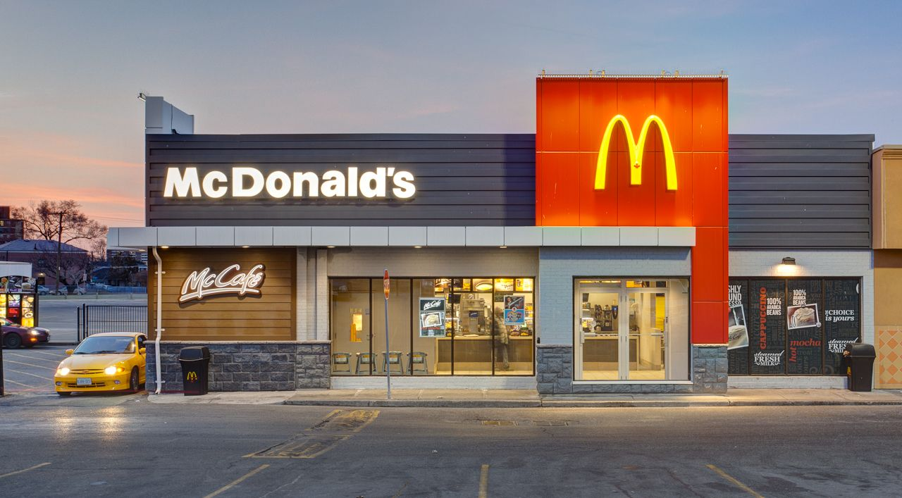
Intermediate forms: Franchising
Partial ownership rights
(Brand & business model)
Franchisor
Franchisees
Fee
Split the tasks
Franchisor performs tasks involving substantial scale economies (e.g. purchasing and branding)
Franchisees build and operate the business
Underperformance is limited through tight quality controls and frequent surprise inspections

Slide 32
Intermediate forms: Strategic alliances and joint ventures
Organizing complex business transactions collectively without sacrificing autonomy:
Strategic alliance: cooperation, coordination, information and resource sharing for a joint project by the participating firms
Joint venture: particular type of strategic alliance where a new independent organization is created and jointly owned by the promoting firms.

Slide 33
Intermediate forms: Strategic alliances and joint ventures
Alliances and joint ventures can be:
Horizontal (firms in the same industry)
Lateral (firms in different industries)
Vertical (firms at different stages of the supply chain)
Alliances rely more on trust, reciprocity, cooperation and information sharing than arm’s length contracts do
Disputes are rarely litigated and tend to be resolved through negotiation

Slide 34
Intermediate forms: Strategic alliances and joint ventures
Factors leading to strategic alliances and joint ventures:
Impediments to comprehensive contracting
Relationship-specific assets by both parties
Complementarities between the resources and capabilities of the parties involved
Advantages in terms of information, knowledge sharing and contextual adaptation (e.g. internationalization)
Transitory nature of the collaboration opportunity

Slide 35
Intermediate forms: Strategic alliances and joint ventures
Drawbacks:
Risk of losing control over proprietary information
Intensive knowledge sharing necessary
Intellectual property protection mechanisms may be ineffective
Agency and influence costs
Coordination issues
No formal mechanisms for making decisions
No formal mechanisms for resolving disputes

Slide 36

Questions?

Slide 37
References
Cabral, Chapter 3 (1st and 2nd edition)
Cabral, Chapter 13 (2nd edition)
Besanko et al. (Economics of Strategy), Chapters 2-4
Shy, Chapter 8.2
Further readings/additional materials:
Montgomery C. 1994. Corporate Diversification. Journal of Economic Perspectives 8(3): 163–178
Better off alone, The Economist, Jul 18 2015
New and interesting music is harder to find than ever, The Economist, Jan 20 2016
The breadth of Alphabet (ex-Google), an example of horizontal (unrelated) diversification: https://www.youtube.com/watch?v=QeA_HojIL14, https://www.youtube.com/watch?v=olFEpeMwgHk

